Slide 1
Introduction to Client-Side Development - CSS
IN712

Slide 2
CSS – cascading style sheets
CSS is a W3C standard for describing the appearance of HTML elements
The principal mechanism for web authors to modify the visual presentation of webpages
With CSS, we can assign font properties, colors, sizes, borders, background images and position elements on the page
CSS tasks such as layout and positioning can be quite complicated
CSS can be added
Directly to any HTML element ( discouraged)
Within the head element
In a separate text file containing only CSS ( preferred)

Slide 3
Benefits of CSS
Improved control over formatting
Degree of control over formatting is significantly better than what is provided in HTML
Improved site maintainability
All formatting can be centralized into one (or a small handful) CSS file/s
Improved accessibility
By keeping presentation out of the HTML, screen readers and other accessibility tools work better, thereby providing a significantly enriched experience for those reliant on accessibility tools
Improved page download speed
Improved output flexibility
CSS can be easily used to adapt a page for different output media

Slide 4
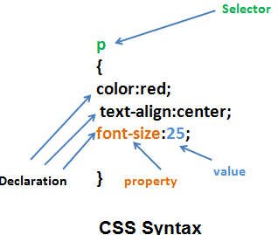
CSS syntax
A CSS document consist of one or more style rules
A rule consist of a selector that identifies the HTML element or elements that will be affected
Selectors are a pattern that is used by the browser to select the HTML elements that will receive the style
The selector is followed by a series of property: value pairs ( a declaration)
Property names are predefined by CSS
Properties are assigned values
Units are dependent upon the property
Predefined list of keywords
Length measurements
Percentages
…

Slide 5
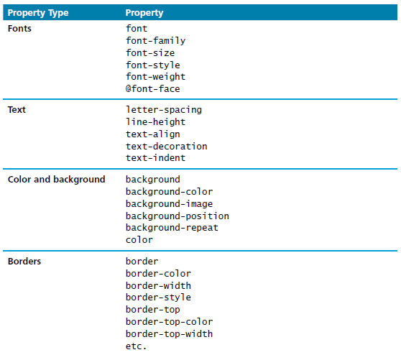
Common CSS properties

Slide 6
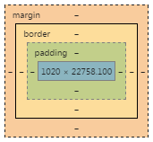
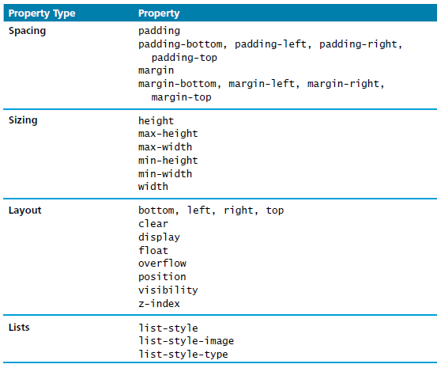
Common CSS properties

Slide 7
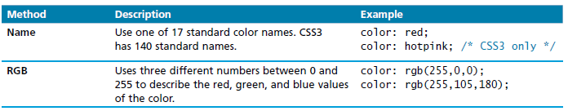
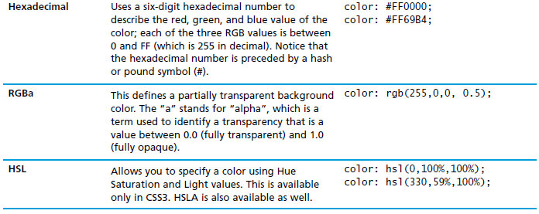
Color values

Slide 8
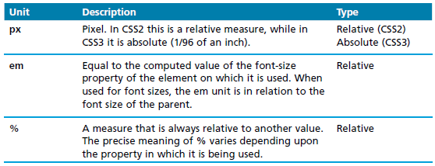
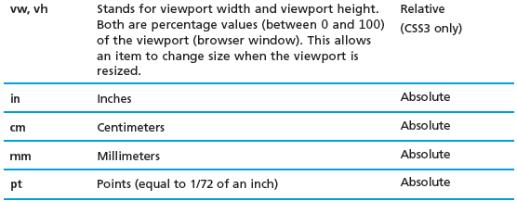
Units

Slide 9

Location of the styles: in-line
Place within an HTML element via the style attribute
An in-line style only affects the element it is defined within
It overrides any other style definition
Using in-line styles is generally discouraged
Increases band consumption
Decreases maintainability
Presentation and content are intermixed
It can be challenging to make consistent in-line style changes across multiple files

Slide 10
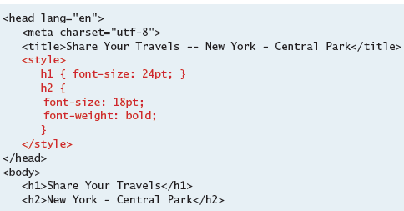
Location of the styles: embedded
Place within the <style> element inside the <head> element of an HTML document
Better than in-line styles but still discouraged
More difficult to consistently style multiple documents

Slide 11
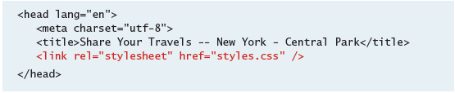
Location of the styles: external style sheet
Style rules placed within a external text file with the .css extension
Provides the best maintainability
When changes are made to an external style sheet, all HTML documents that reference that style sheet will automatically use the updated version
The browser is able to cache the external style sheet
Can improve the performance of the site as well

Slide 12
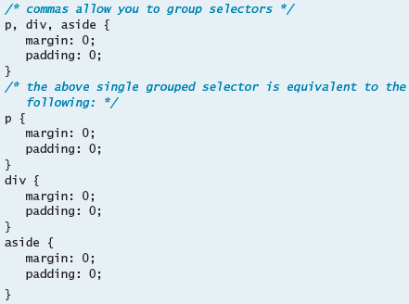
Element selectors
select all instances of a given HTML element

Slide 13
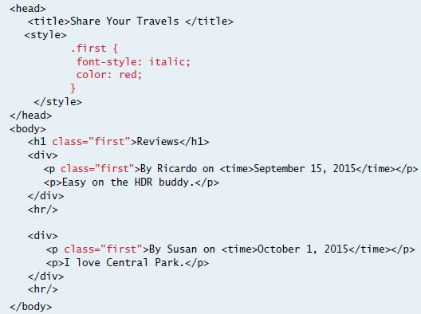
Class selectors
Allows to simultaneously target different HTML elements

Slide 14
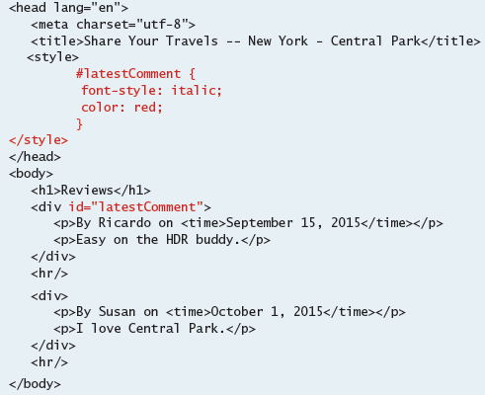
Id selectors
Allows the target a specific element by its id attribute

Slide 15
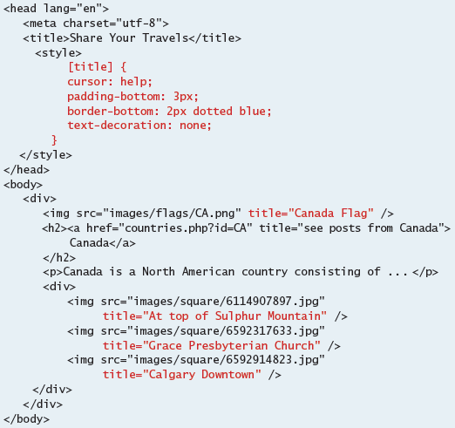
Attribute selectors
Provide a way to select HTML elements either by the presence of an element attribute or by the value of an attribute

Slide 16
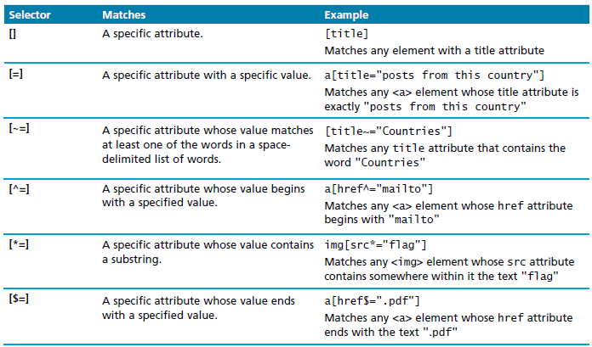
Attribute selectors

Slide 17
Pseudo-Element and Pseudo-Class Selectors
A pseudo-element selector is a way to select something that does not exist explicitly as an element in the HTML document tree but which is still a recognizable selectable object.
For instance, you can select the first line or first letter of any HTML element using a pseudo-element selector.
A pseudo-class selector does apply to an HTML element, but targets either a particular state or, in CSS3, a variety of family relationships.

Slide 18
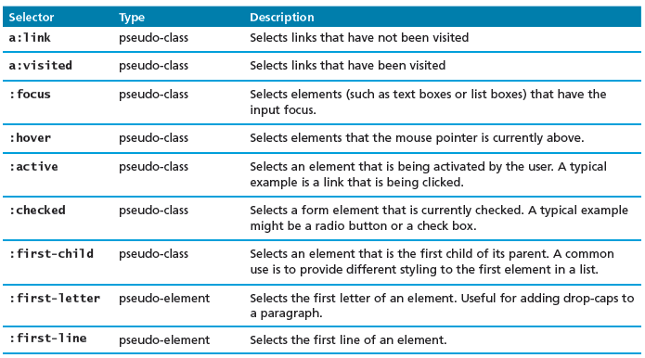
Pseudo-Element and Pseudo-Class Selectors

Slide 19
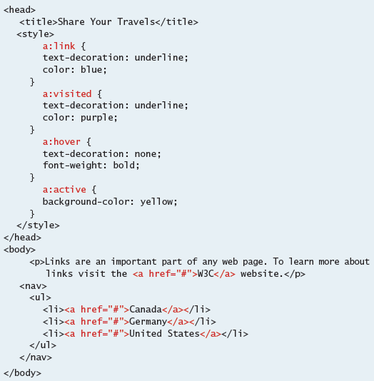
Pseudo-Element and Pseudo-Class Selectors

Slide 20
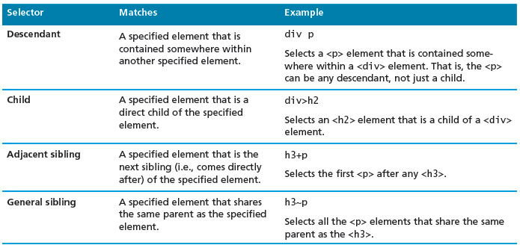
Contextual selectors
Allows you to select elements based on their ancestors, descendants or siblings

Slide 21
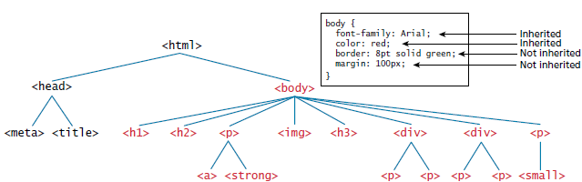
The Cascade: How Styles Interact
Inheritance Many (but not all) CSS properties affect not only themselves but their descendants as well.
Font, color, list, and text properties are inheritable;
layout, sizing, border, background, and spacing properties are not.

Slide 22
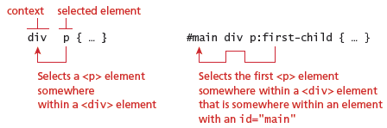
Contextual selectors

Slide 23
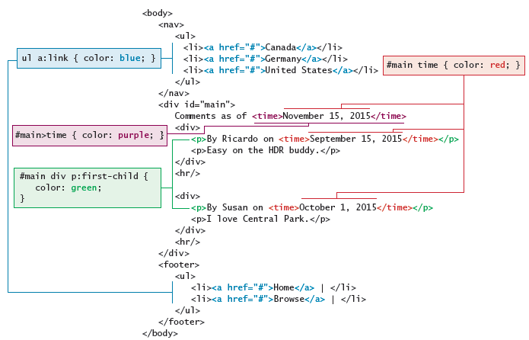
Contextual selectors

Slide 24
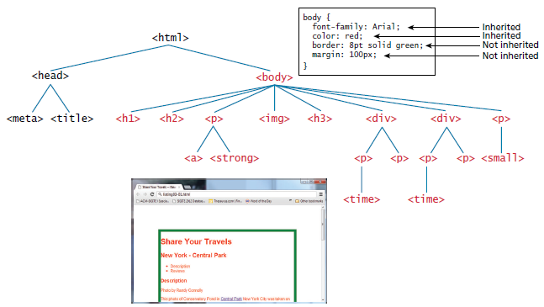
The Cascade: How Styles Interact
Inheritance: many but not all CSS properties affect not only themselves but their descendants as well

Slide 25
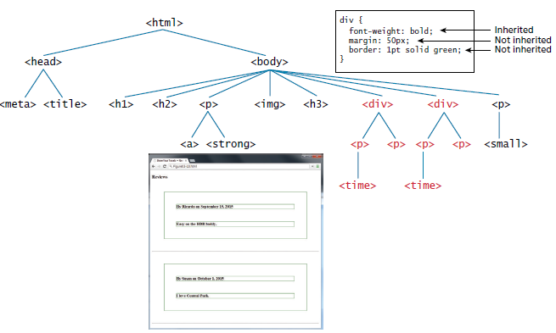
The Cascade: How Styles Interact
Inheritance: many but not all CSS properties affect not only themselves but their descendants as well

Slide 26
The Cascade: How Styles Interact
specificity refers to how the browser determines which style rule takes precedence when more than one style rule could be applied to the same element
The browser assigns a weight to each style rule
When several rules apply, the one with the greatest weight takes precedence
The more specific the selector, the more it takes precedence
class selectors take precedence over element selectors
id selectors take precedence over class selectors

Slide 27
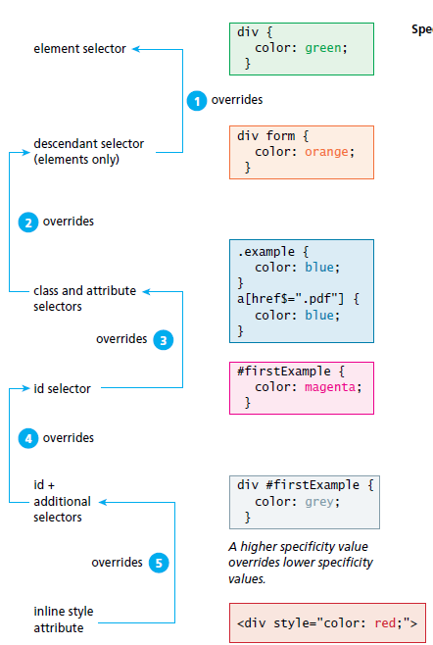
Specificity algorithm

Slide 28
The Cascade: How Styles Interact
Location: when rules have the same specificity, the latest are given more weight
An in-line style will override one defined in an external style sheet or an embedded stylesheet
When the same style properties is defined multiple times within a single declaration block, the last one will take precedence

Slide 29
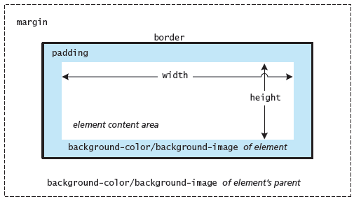
The box model
In CSS, all HTML elements exist within an element box

Slide 30
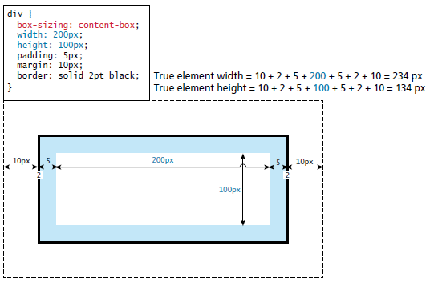
The box model

Slide 31
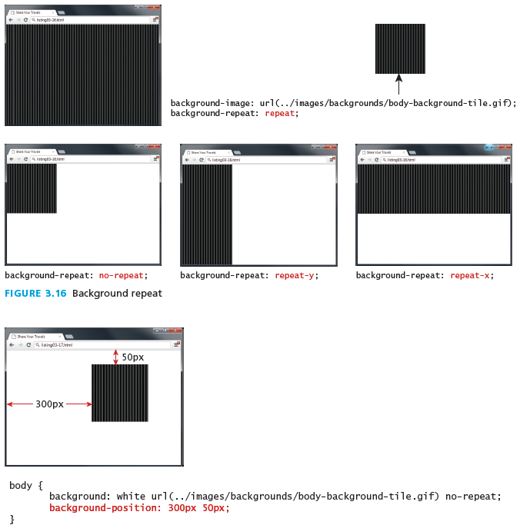
Background

Slide 32
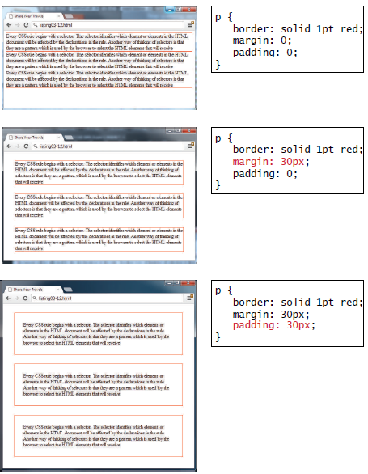
Borders, margins and padding

Slide 33
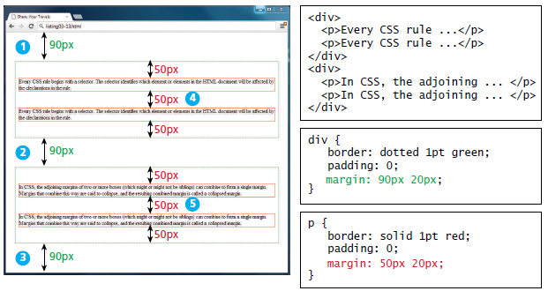
Collapsing vertical margins

Slide 34
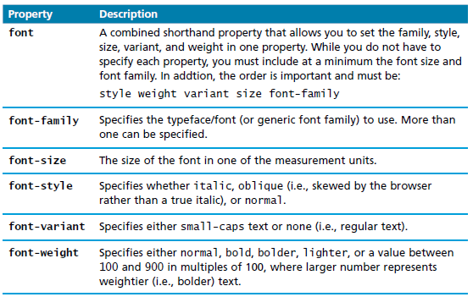
CSS text styling – font properties

Slide 35
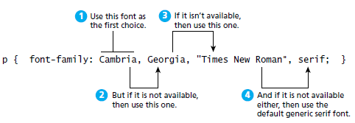
Specifying the font family

Slide 36
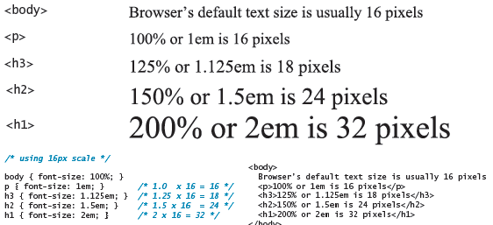
CSS text styling – font sizes

Slide 37
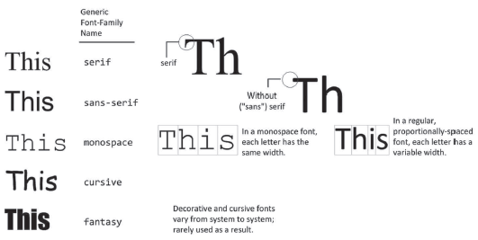
Different font families

Slide 38
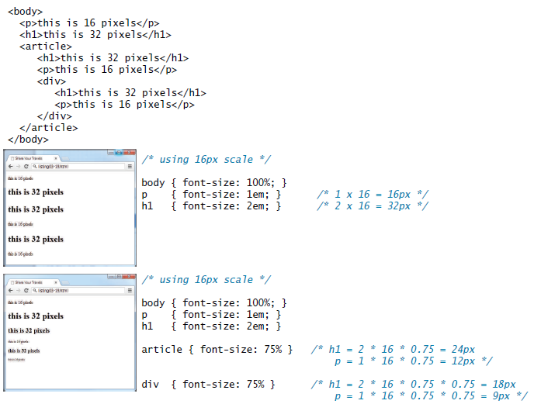
Font size issues
Solution: use rem units!

Slide 39
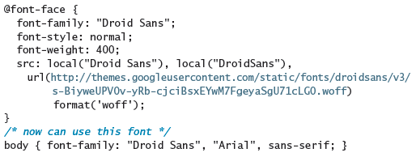
@font-face
With the @font-face rule, you do no longer need to use one of the "web-safe" fonts

Slide 40
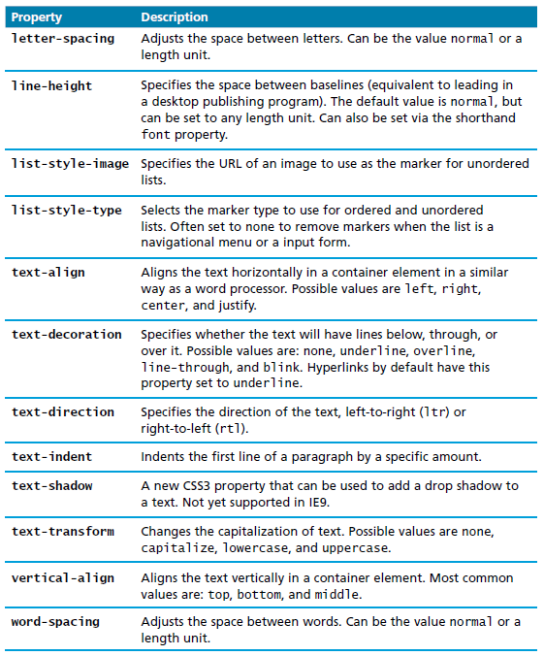
Text properties

Slide 41
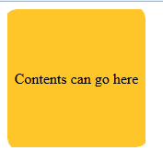
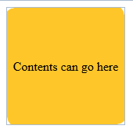
Some new things in CSS3
Rounded corners

Slide 42
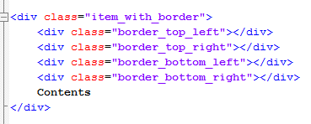
Rounded Corners – Old Style

Slide 43
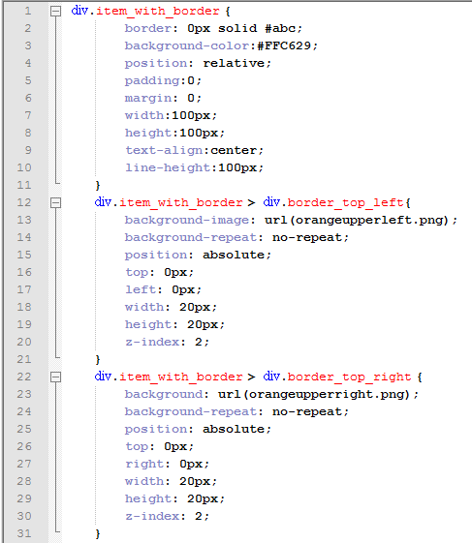
Rounded Corners – Old Style

Slide 44

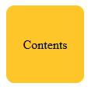
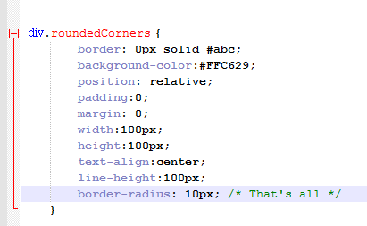
Rounded Corners – CSS3
Border-radius
Notes:
Easier and perfect.

Slide 45
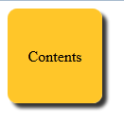

Box Shadow
Args are: horizontal offset, vertical offset, width (blur), colour

Slide 46
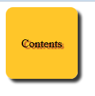

Text Shadow

Slide 47
Columns
Multi-column text used to involve divs and floating and all sorts of nonsense.
Now it’s just a CSS line
Note the vendor prefix: Some CSS3 features are so new that they are implemented differently in the different browsers and need a brower-specific “vendor prefix”.
-moz- prefix is for mozilla
-webkit- for Chrome and Safari
-o- for Opera
-ms- for Microsoft

Slide 48
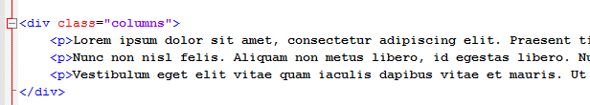
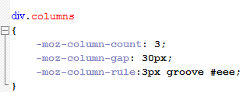
Columns

Slide 49
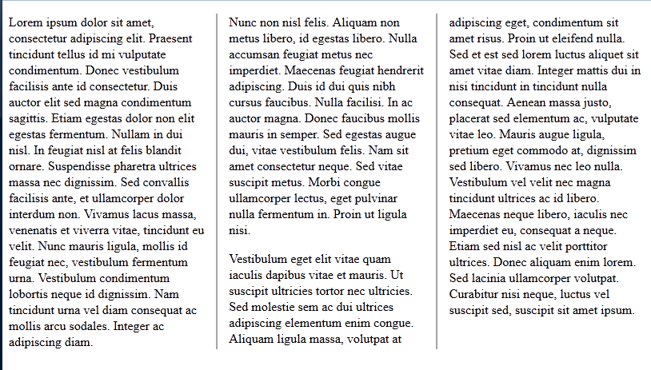
Columns

Slide 50
Some useful resources
Css3 generator
http://layerstyles.org/builder.html
http://www.colorzilla.com/gradient-editor/
Csslint.net for CSS error detection
Particularly useful:
http://liveweave.com/

Slide 51
Demo
CSS Demo

Slide 52
Practical
Provided:
HTML
Image files if needed
Image captures of the outputs
You add the CSS.
Do not touch the HTML body except to add class and id attributes.

